Slide 1
SSP Self Sovereign Passport
by Umut Yorulmaz
Advisors: Dave Mckay, Andrew Starling

Slide 2
’’Not your keys, not your identity.’’ Andreas & Umut ’’How do we know who we are ?’’ An existentialist

Slide 3
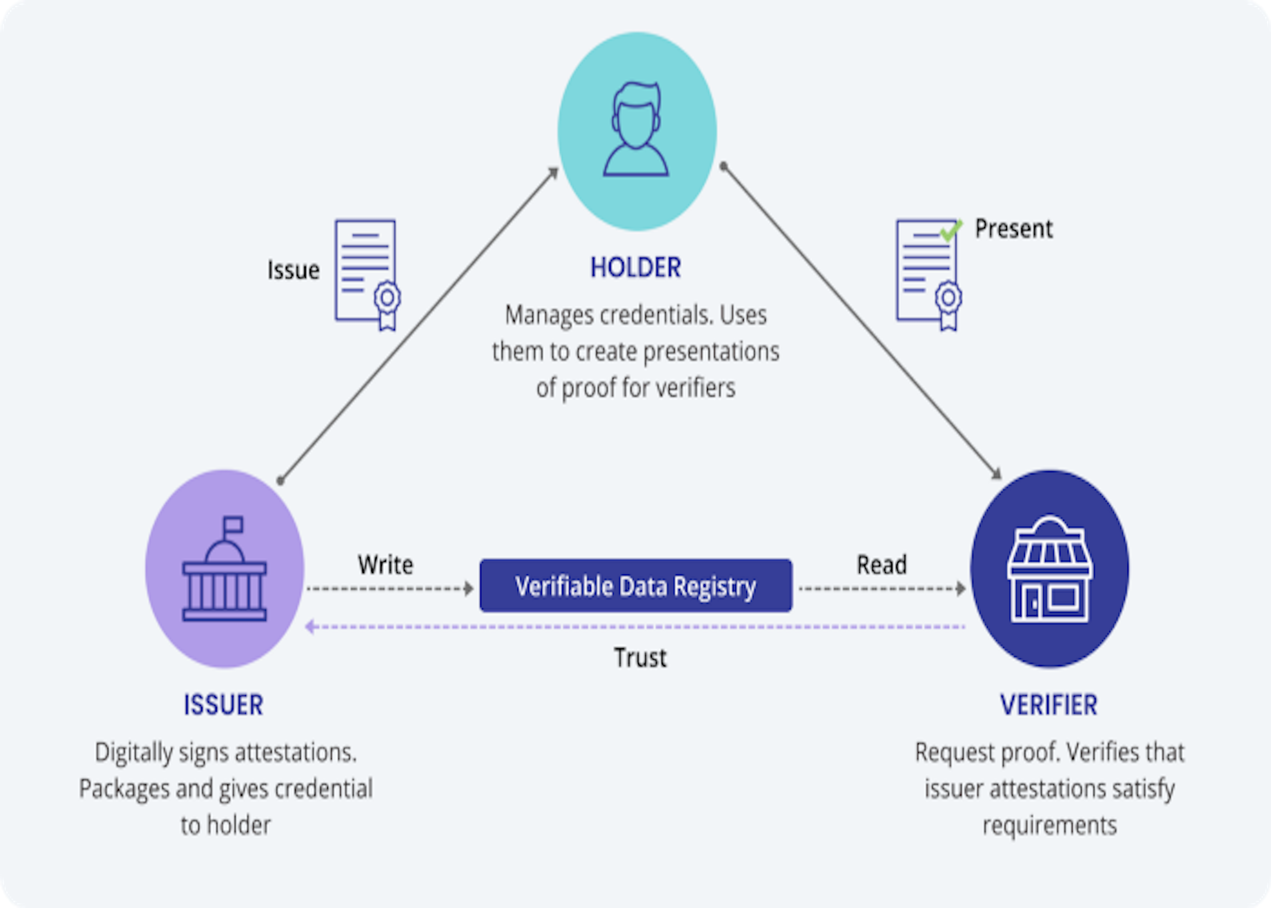
What is SSP ?
01
Subset of SSI (self sovereign identity); cryptographically secured digital identity (passport) doesn’t depend on 3rd party service provider

Slide 4
Problems Statement
02
1
2
3
Current situation
Privacy
Authenticity
Offline
Revealing unnecessary information
Lack of Authenticity
Lack of Online processing
Problems

Slide 5

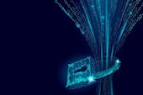

Benefits
03
01
03
Genuine Credentials
Improved Privacy
Online Processing
02

Slide 6
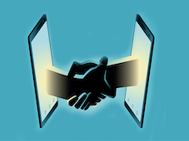
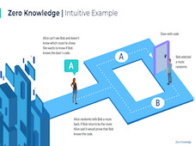

Features
P2P
Zero Knowledge Proofs
Verifiable Credentials
04

Slide 7
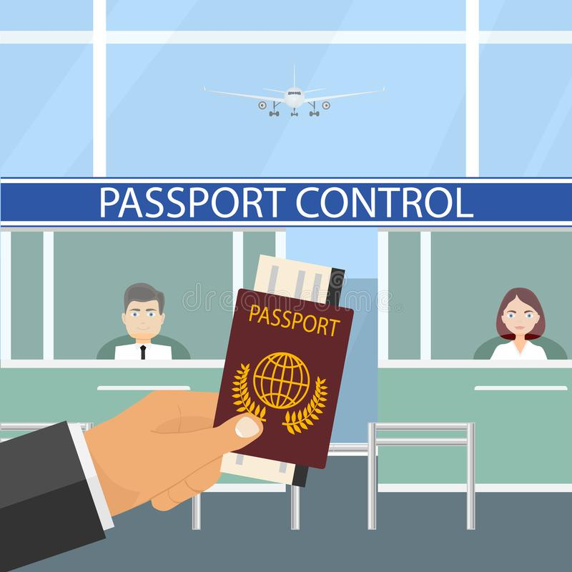
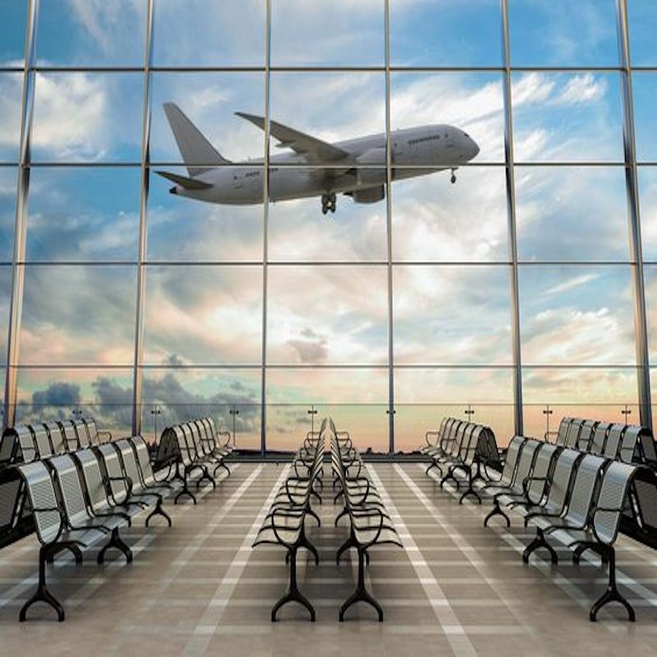
Market Opportunity
Governments
Travel Industry
05

Slide 8


06
EMAIL ME FOR A DETAILED DEMO
umutyor43@gmail.com

